Slide 1

Project 2: Credit K-Means Clustering Analysis DSC 680 Manuel Duran 14 Min 48 Secs

Slide 2
Presentation Schedule
Data
Understanding\Prepartion
EDA\Method
Intepration\Conclusion

Slide 3
Data Preparation\Understanding
Dataset
Discovered on Kaggle.com
Features many categorical variables to utilize for K-Means Clustering.
Dataset is for a German Bank
Preparation
Removal of Null Values from the dataset
Adjust not categorical variables for use of K-Means
Creation of Job Directory
Plan
To utilize the dataset to discover valuable insights
To generate a marketing plan that fits our customers needs.

Slide 4
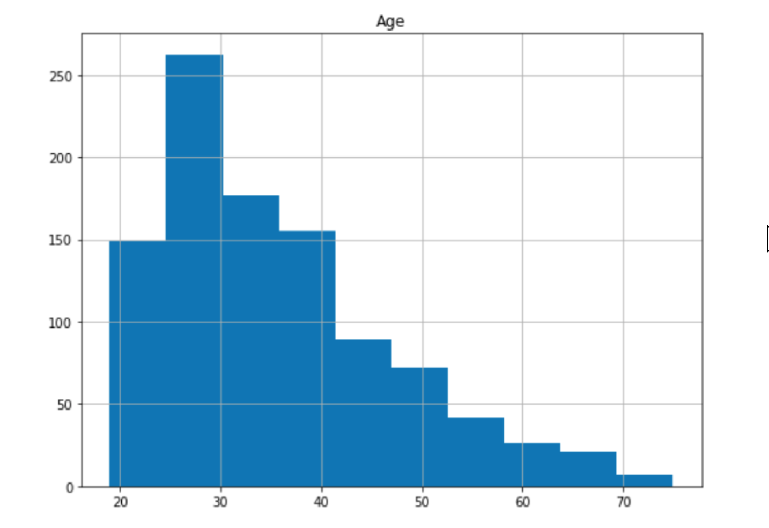
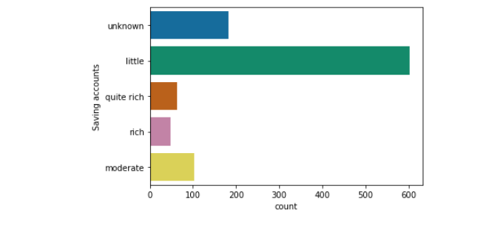
EDA

Slide 5
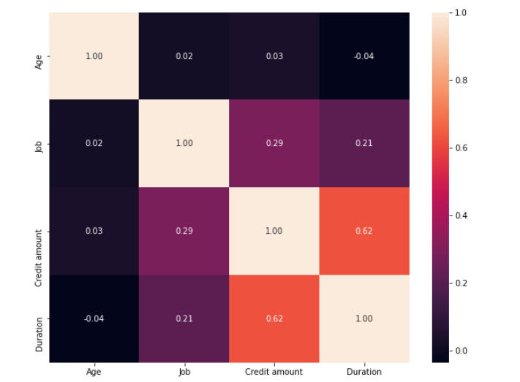
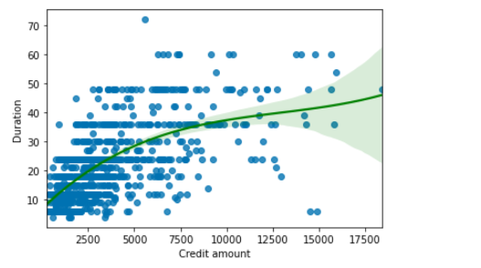
EDA Cont.

Slide 6
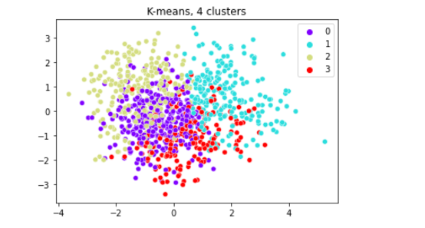
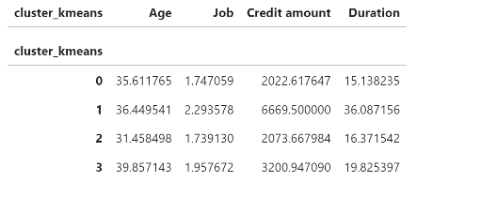
Method

Slide 7

Interpetation\Conclusion
Insights Discovered
Target Marketing Age: 20-35
Faster Payment: Cluster 2 and 3
Market to both Genders: Clusters 1 and 2
Primary Reasoning for credit
Car
Radio\TV
Furniture and Equipment
Limitations\Liabilities Discovered
Cluster 2 and 3: No Female Representation
Cluster 1 and 2: Longer Durations
Lack of customer data
Lack of females within the data

Slide 8

Suggestion Plan\Final Remarks
Rewards Plan
Partner with another Company
Provide Discounts with each payment duration

Slide 9
GitHub & Contact
Project 2:
Github: https://github.com/mannyoduran/DSC680-Projects/tree/main/Project%202
Contacted: Mannyoduran@gmail.com

